Slide 1
Notes:
Hello everyone, welcome to our super demo!
In this demo, I will show you how to migrate SAS data sets with different encoding into SAS Viya with UTF8 encoding.

Slide 2
Fang Meng, SAS Institute Inc.
Fang Meng is Test at SAS Institute Inc. Beijing R&D. I work in SAS solution validation and implementation support in CI products.
Elizabeth Bales, SAS Institute Inc.
Elizabeth is a Senior Software Manager in the Platform Research and Development Division at SAS Institute. Elizabeth manages the Software Globalization R&D team which provides Internationalization (I18N) features for SAS products and tools that find I18N violations in software.

Slide 3
Using CVP for the Best Migration Experience
Fang Meng, SAS Institute Inc.

Slide 4
Outline
Transcode character variables to SAS Viya with CEDA
Expand the character variables space with CVP engine in SAS Viya
Migrate format catalogs to SAS Viya
Migrate indexes to SAS Viya
Demo

Slide 5


Background
PAST
PRESENT
SAS Viya
(UTF-8 encoding)
Notes:
Nowdays, many organizations often need to handle the characters of several different languages in the same process.
SAS supports many encodings. Most of the encodings represent characters for a specific language or region.
To handle data including different languages, SAS Viya with UTF-8 encoding is your best choice. SAS Viya with UTF-8 encoding includes almost all of the characters available in modern software today.
What if you have SAS datasets with non-UTF8 encoding generated by you legacy SAS system and you want to migrate the dataset into SAS Viya.

Slide 6
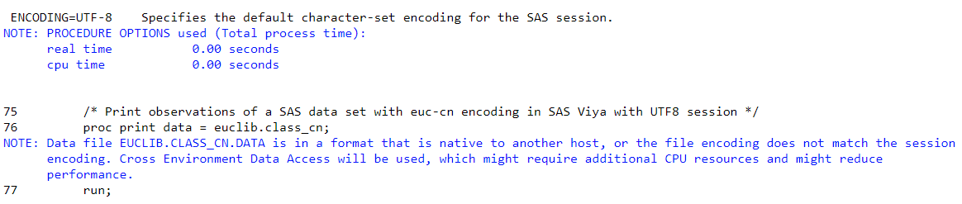
Transcode character variables to UTF-8 encoding with CEDA(1/2)
Cross Environment Data Access (CEDA)
Transcode the characters in input data from its original encoding to the current session encoding if the encodings are not the same.
Run automatically and transparently.
Notes:
Here SAS has provided several techniques to solve the problem. CEDA is one of them.
CEDA means ….. It is designed to enable data created in a different OS or different encoding to be processed in current encoding. When processing non-UTF-8 SAS data set in SAS Viya, CEDA will be invoked and CEDA will transcode characters into UTF-8 encoding.
This process is automatic and transparent
Here is an snapshot. We try to ….
CEDA does not update the original SAS data set and it will consume system resources every time you read data. If you need to use the data in SAS Viya from time to time, you can save a new SAS data set in SAS Viya.

Slide 7
Transcode character variables to UTF-8 encoding with CEDA(2/2)
Truncation warnings or errors occur when the length of character variable is not enough to store the UTF-8 characters.
CVP
Using
Euro symbol | WLATIN1 | UTF-8
€ | 80 | E282AC
engine
to expand the space of character variables.
1 byte | 3 bytes
Notes:
In many cases, CEDA can transcode the characters correctly. But sometimes, there might be truncation warnings or errors when accessing data with CEDA.
That’s because UTF-8 is a multi-byte. Many characters that can be represented by one byte in a single-byte (SBCS) encoding need to be represented by 2,3 or more bytes in UTF-8.
For example, the Euro symbol, €, is represented by one byte in WLATIN1 encoding in SAS. In SAS Viya, the Euro symbol must be represented by 3 bytes.
If the character variables space is not enough, you need to use CVP engine to expand the character variable space to prevent truncation issues.

Slide 8
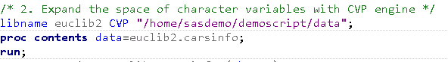
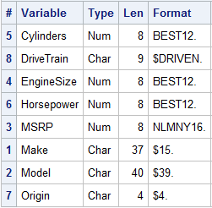
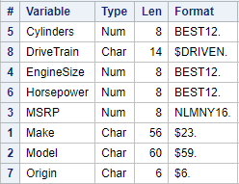
Using CVP Engine to expand the space (1/2)
Character Variables Padding (CVP) engine expands the length of character variables. By default, the expansion amount is 1.5 times in 9.4M5, and 0(AUTO) in SAS Viya.
CVP LIBNAME
Notes:
CVPMULTIPLIER|CVPMULT=multiplier Specifies a multiplier value in order to expand character variable lengths. The algorithm is new_length = ceiling(old_length * multiplier). In SAS 9, the default value is 1.5. In SAS Viya, the default value is 0 which means the multiplier is determined by CVP engine automatically.
CVP engine provide a feature to set CVPMultiplier automatically (CVPMultiplier=0). This session describes the algorithm in details.
If CVPSEUDO is used:
In UTF-8 session, the multiplier will be set to 3 for JA and ZH, and 2 for other languages.
In MVS, the multiplier will be set to 4 for JA and ZH, and 1 for other languages.
In other sessions, the multiplier will be set to 2 for JA and ZH, and 1 for other languages.
If CVPSEUDO is not used, the value will be set based on the encoding of input dataset and the encoding of SAS session using CVP:
In UTF-8 session:
If the input dataset is in us-ascii (7 bits ASCII) or UTF-8 encoding, the multiplier will be 1.
Else, if the maximum character width of the input dataset is 1, the multiplier will be 2, otherwise, the multiplier will be 1.5.
In non-UTF-8 session:
If the session encoding is single-byte, the multiplier will be 1.
Else if the session encoding is EUC-JP, the multiplier will be 2.
Else, if the maximum character with of session encoding is 4 bytes, the multiplier will be 2, else, it will be 1.

Slide 9
Using CVP Engine to expand the space (2/2)
CVPMULTIPLIER can specify the expansion amount.
CVPBYTES can specify the number of bytes.
CVPFORMATWIDTH can specify whether to expand the character format width.
WLATIN1 1 byte | Character | Column Length
 | € | 1
UTF-8 3 byte | Character | Column Length
 | € | 3
/* Expand the character variables length 3 times*/
libname euclib2 CVP "/home/sasdemo/demoscript/data" CVPMULTIPLIER=3;
Notes:
If you need to change the expansion rate, you can specify CVPMULTIPLIER , CVPBYTES
CVPMULTIPLIER can … CVPBYTES can …
With CVPFORMATWIDTH
By using CVP engine, CEDA can transcode the characters in SAS data set into SAS Viya successfully. However, if the SAS data set has format catalogs, index, you might need to migrate them to UTF-8 manually.

Slide 10
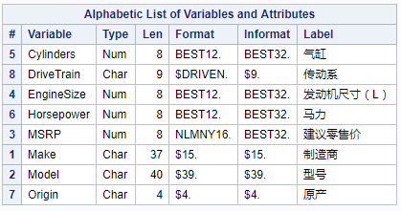
Migrate Format Catalog to UTF-8 (1/2)
CEDA does not transcode characters in format catalog.
If you created user-defined formats in another encoding, you will need to migrate those to the SAS Viya manually.
/*
* The definition of
* the user-defined format.
*/
proc format lib=euclib;
value $driven 'D’='双驱动'
‘F’='前驱动'
'R’='后驱动';
run;
Notes:
CEDA does not support to transcode SAS format catalogs.
Therefore. If you created user-defined formats in another encoding, you will need to migrate those to the SAS Viya manually.
On the lower left, you can see that DriveTrain has a character format Driven. On the right, you can see the definition of user defined format.

Slide 11
Migrate Format Catalog to UTF-8 (2/2)
Steps to migrate the format catalog to UTF-8 session.
/* Create format data set in EUC-CN Session */
libname euclib "C:\SGF2020\use_cvp_to_migrate_to_viya";
proc format cntlout=euclib.cnformat lib=euclib;
run;
data euclib.cnformat;
set euclib.cnformat;
keep FMTNAME START LABEL TYPE;
run;
Output format catalog to SAS data set in the SAS session where you created the format.
/* Run the code in SAS Viya with UTF-8 encoding */
libname euclib2 CVP "/home/sasdemo/demoscript/data";
libname u8lib “/home/sasdemo/demoscript/u8_data";
proc format cntlin=euclib2.cnformat lib=u8lib;
run;
2. Re-create the format using the
outputted SAS data set in SAS Viya
Notes:
Here there are 2 steps to finish the migration. In the 1st step, you need to run “proc format” with cntlout option to output the format definition into a sas data set. You need to run it in the SAS session where this format is generated.
Then you need to run “proc format” with cntlin option to re-create the format and this need to be run in SAS Viya.

Slide 12
Migrate indexes (1/2)
CEDA does not always transcode characters in indexes.
To migrate indexes, it is required to re-create them in UTF-8.
Notes:
Also CEDA does not always transcode characters in indexes.
So to migrate indexes, you need to re-create the index manually.

Slide 13
Migrate indexes (2/2)
Steps to migrate the indexes to UTF-8 session.
/* Output the index in EUC-CN session */
proc datasets lib=euclib nolist;
contents data=carsinfo out2= euclib.index;
quit;
1. Output SAS index to a
SAS data set in the SAS session
where you created the SAS index.
2. Get the code from Recreate
column.
3. Re-create the index for migrated
UTF-8 SAS data set.
/* Recreate the index in UTF-8 session*/
proc datasets lib=u8lib nolist;
modify carsinfo;
Index create Make / Updatecentiles=5;
quit;
Notes:
Here are the steps:
Firstly, run proc datasets in the original SAS session. Output the indexes info into an output data set by setting OUT2 option.
We can get the index info in the RECREATE column in SAS data set.
Then you need to run PROC DATASETS in SAS UTF-8 to recreate the indexes and integrity constraints for the UTF-8 version of your SAS data sets.
You can use a program to re-create the indexes manually.

Slide 14
Demo

Slide 15
Take Away
Cross Environment Data Access
CVP can expand the character variable length
CVPMULTIPLIER
CVPBYTES
CVPFORMATWIDTH
SAS Format and index
Migrate manually (format procedure)
Migrate manually (datasets procedure)

Slide 16
Thank you!
Contact Information fang.meng@sas.com
Reminder: Complete your session survey in the conference mobile app.

